Slide 1


Welcome To
&
Training

Slide 2
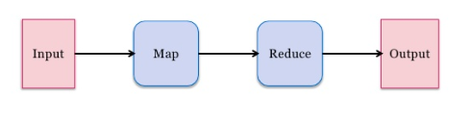
Introduction to Mapreduce
MapReduce is a programming framework that allows us to perform distributed and parallel processing on large data sets in a distributed environment.
Distributed data processing paradigm
Designed especially for batch processing
It was first introduced at Google
Mapreduce consists of two distinct tasks – Map and Reduce.

Slide 3
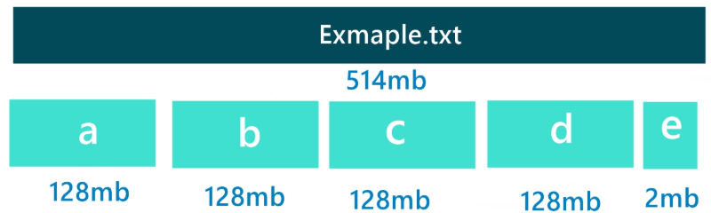
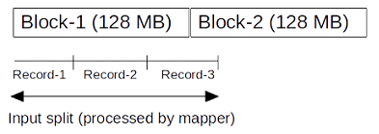
Map Reduce Terminologies
InputSplit - Input to a MapReduce job is divided into fixed-size pieces called input splits.
Mapper - This is very first phase in the execution of map-reduce program. In this phase data in each split is passed to a mapping function to produce output values. It reads the input in the form of keyvalue pairs and generates output in the form of keyvalue pairs.
Shuffling- This phase reads output of the mapper, merge and sort the data based on the key.
Reducer - In this phase, output values from Shuffling phase are aggregated. This phase combines values from Shuffling phase and returns a single output value. In short, this phase summarizes the complete dataset.

Slide 4

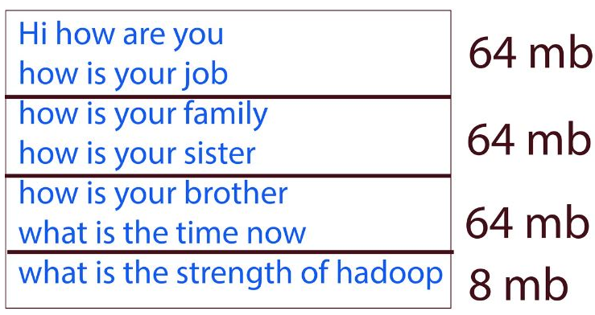
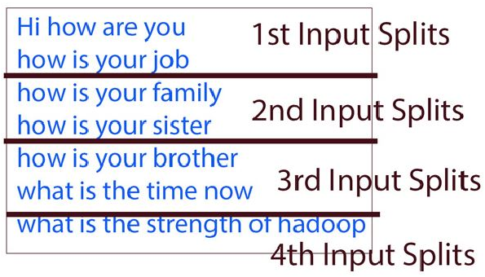
Input Split

Slide 5
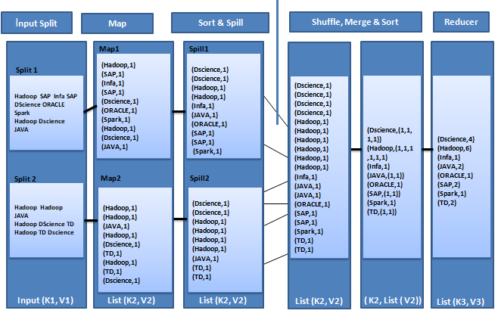
Map Reduce Flow
Map Phase
Reduce Phase

Slide 6
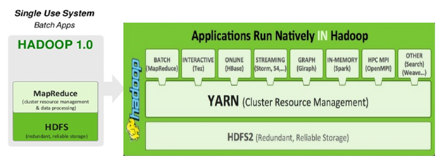
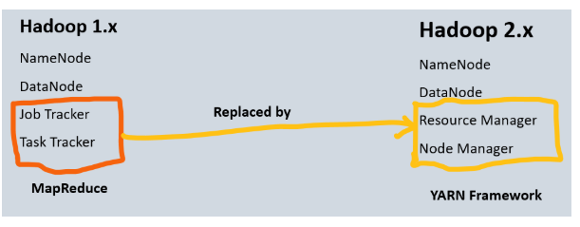
Hadoop 1 vs Hadoop 2
YARN is the framework responsible for providing the computational resources (e.g., CPUs, memory, etc.) needed for application executions.
YARN sits between HDFS and the processing engines being used to run applications.
Yarn allows different data processing engines like graph processing, interactive processing, stream processing as well as batch processing to run and process data stored in HDFS

Slide 7
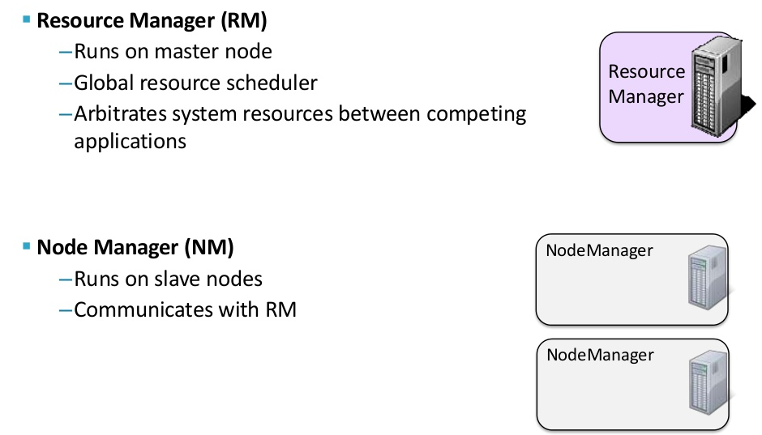
YARN Daemons

Slide 8
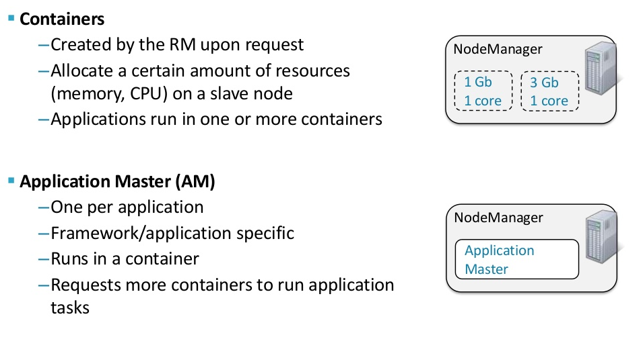
Running Application on YARN

Slide 9
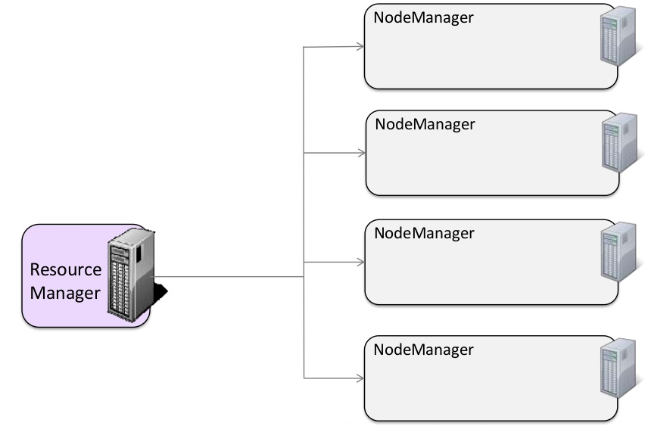
YARN Cluster

Slide 10
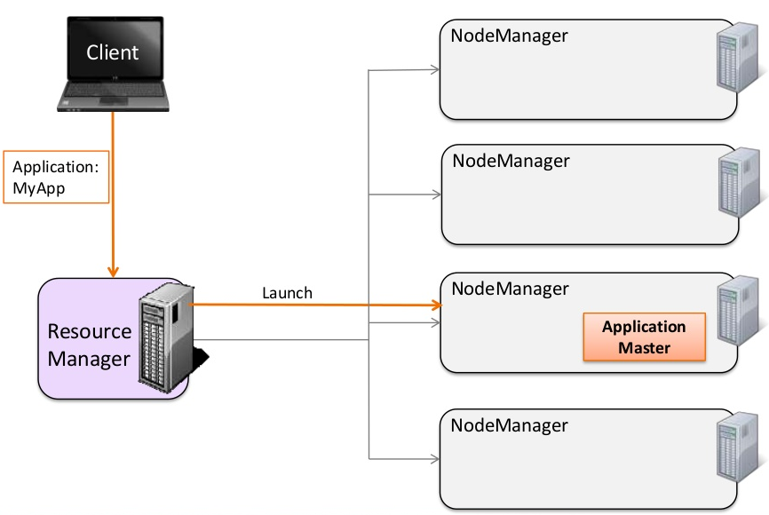
YARN Cluster: Running an Application

Slide 11
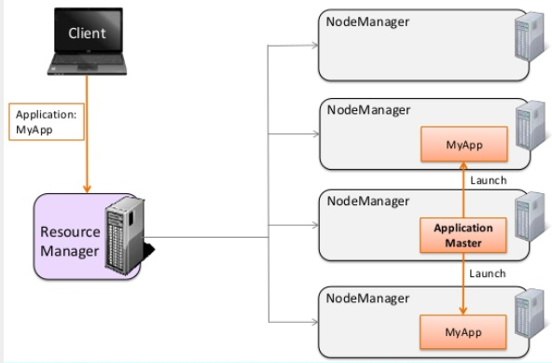
YARN Cluster: Running an Application

Slide 12
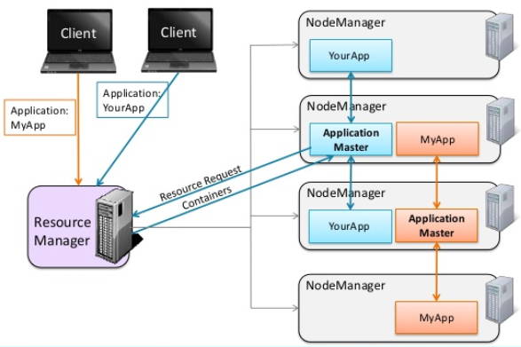
YARN Cluster: Running an Application

Slide 13
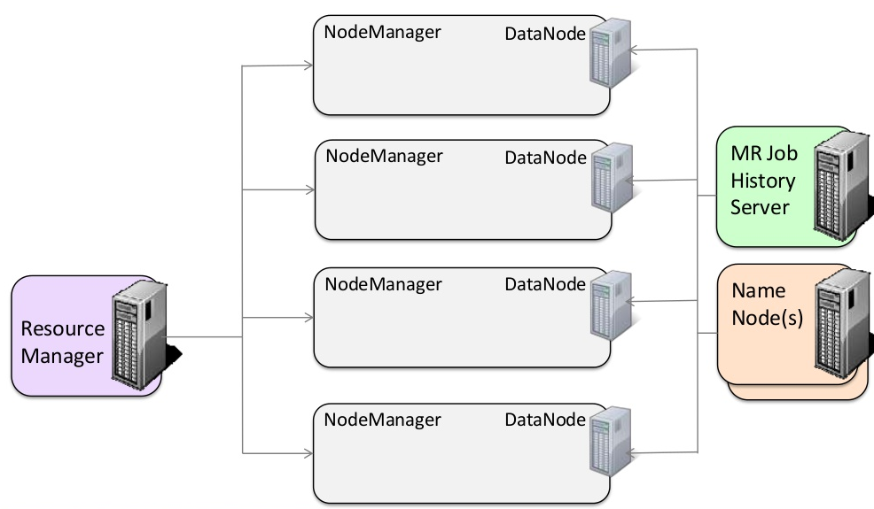
Hadoop Cluster

Slide 14
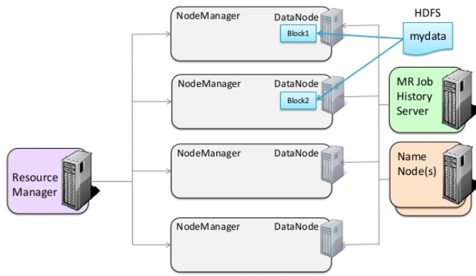
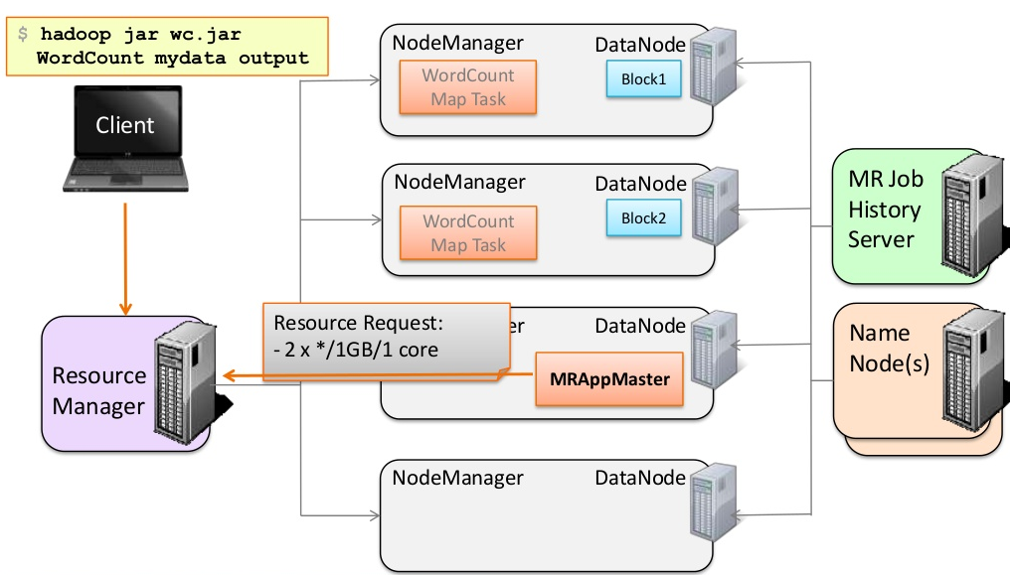
Hadoop Cluster

Slide 15
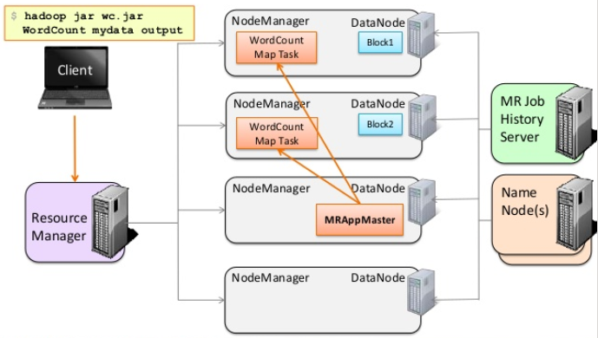
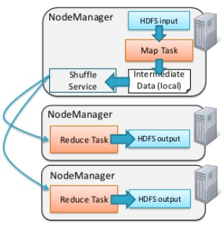
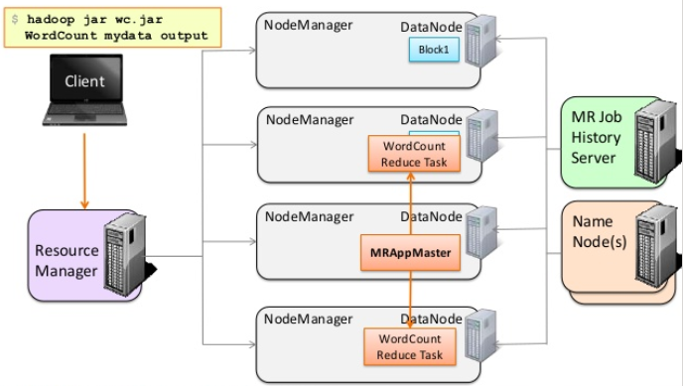
Hadoop Cluster

Slide 16
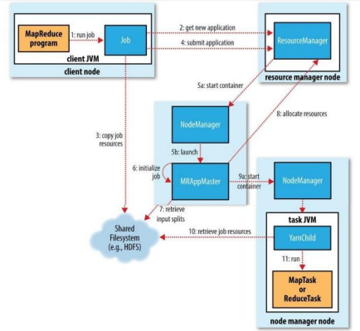
Map Reduce Life Cycle
1. MapReduce app submit job to Hadoop client
2. Client ask ResourceManager to get app ID
3. Copy job resources to HDFS:
a. Checks the output specification of the job
b. Computes the input splits for the job
c. Copy Jar and throw error if need.
4. Submit Application
5. ResourceManager:
a. Allocate container on some node
b. Run ApplicationMaster on that node
6. ApplicationMaster initialize job
7. Retrieve input splits
8. Allocate resources and start container
9. step 10 Retrieve resource for map or reduce task
10. step 11 run map or reduce task

Slide 17
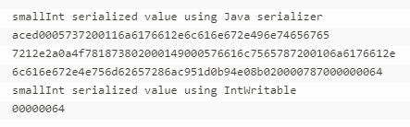
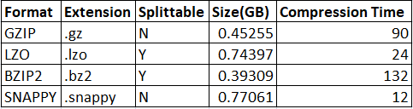
Data Mechanics
Serialization - Deserialization
Compression Techniques

